Slide 1



Mastering the Art of Conversations
By: Jordan Thibodeau

Slide 2
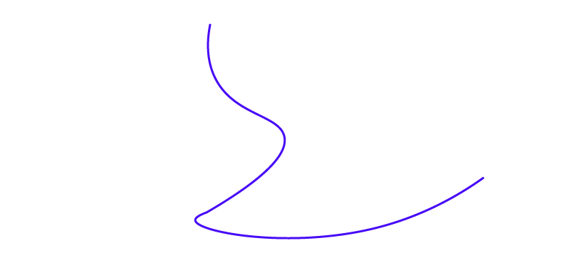
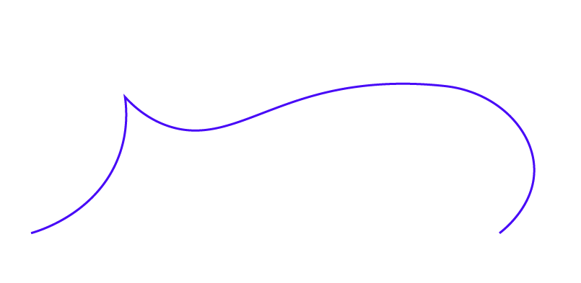
Lesson 7:
The power of like, laugh, learn & appreciate

Slide 3
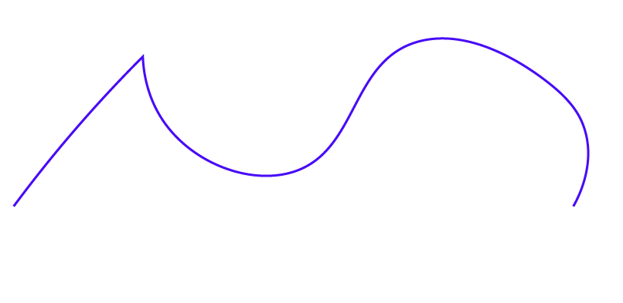
Our conversations transmit knowledge and emotion
As soon as our conversation is over, that person will take what they have learned from the conservation and share it throughout her network
How you make others feel spreads across their network, known as Emotional Contagion
How you make that person feel dictates how the other people in their network feel
A person is
15%
more likely to be happy if they are connected to a happy person

Slide 4

So what does this mean for a conversationalist?
Your goal is, at the least, to avoid passing on negative vibes in your conversations
It doesn’t mean you become a perennially positive person that avoids conflict at all costs
Research from the Mayo Clinic shows that positive thinking leads to an increased life span, lower rates of depression, and better cardiovascular health

Slide 5
So how do we do this?
Like
Share a recent positive experience with the other person. Did you recently see a good movie? Have you read a good book? Did you have a great meal at a restaurant?
Learn
If you learned something that helped you grow, share it! Did you learn something from a book? Did you experience something that provided you with a helpful takeaway?
Laugh
Think of something that has made you laugh recently. Did you hear a good joke? Did something funny happen to you in the last few days?
Appreciate
Similar to “Like”, but this deserves its own section because people are starving for sincere validation. Did the person do something for you that was great? Did they recently get promoted? Did they work hard on a project?

Slide 6
To Do:
Please complete the following homework exercise
Before you speak, pick something from “like, laugh, learn and appreciate” that you can use for your conversation.
The next conversation you have with someone, share this idea with them. See how they react and if it lifts their spirits.
Recommended Reading:
Connected by Nicholas A. Christakis and James H. Fowler
Real Influence: Persuade Without Pushing and Gain Without Giving In by Mark Goulston & Dr. John Ullmen

