Slide 1

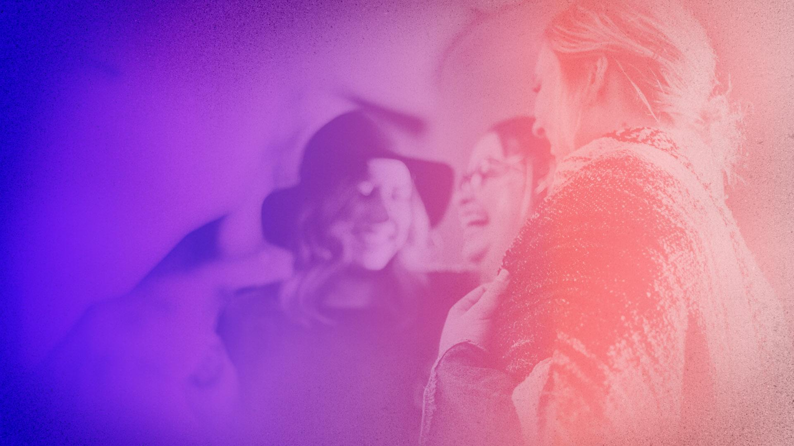

Mastering the Art of Conversations
By: Jordan Thibodeau

Slide 2


Lesson 6:
Conversation Hooks

Slide 3

Conversation Openers
A lot of time is spent on trying to figure out the perfect thing to say to open a conversation
To make things worse, you won’t know what to say after you used the conversation opener
There’s no magic trick for starting conversations
Each conversation is unique and there’s no rulebook on how to start them
If you don’t know anything about the person, where do you begin?

Slide 4

Conversation Hooks
Like it or not, people perceive you based on your actions and what you wear
A conversation hook can be any object or action that provides you with a slight tell about the person, which makes it easier to start a conversation
Examples of conversation hooks:
Clothing with your favorite band, Movie, or sports team on it.
Your cellphone with a decorative Star Wars case.
The book or magazine you took to the coffee shop

Slide 5

Conversation Hooks are Tribal
Not only do conversation hooks represent what you like, but also they indicate what tribe you belong to
If someone indicates they are part of your tribe, it means:
You are inclined to like the person because they are similar to you.
You have a common interest you can talk about.
You now have a channel of communication to get the conversation going.

Slide 6
To Do:
Please complete the following homework exercise
The next time you see someone, see how many conversations hooks you can spot.
What do the conversation hooks tell you about the person?
Try to use the conversation hooks to start a conversation.

