Slide 1

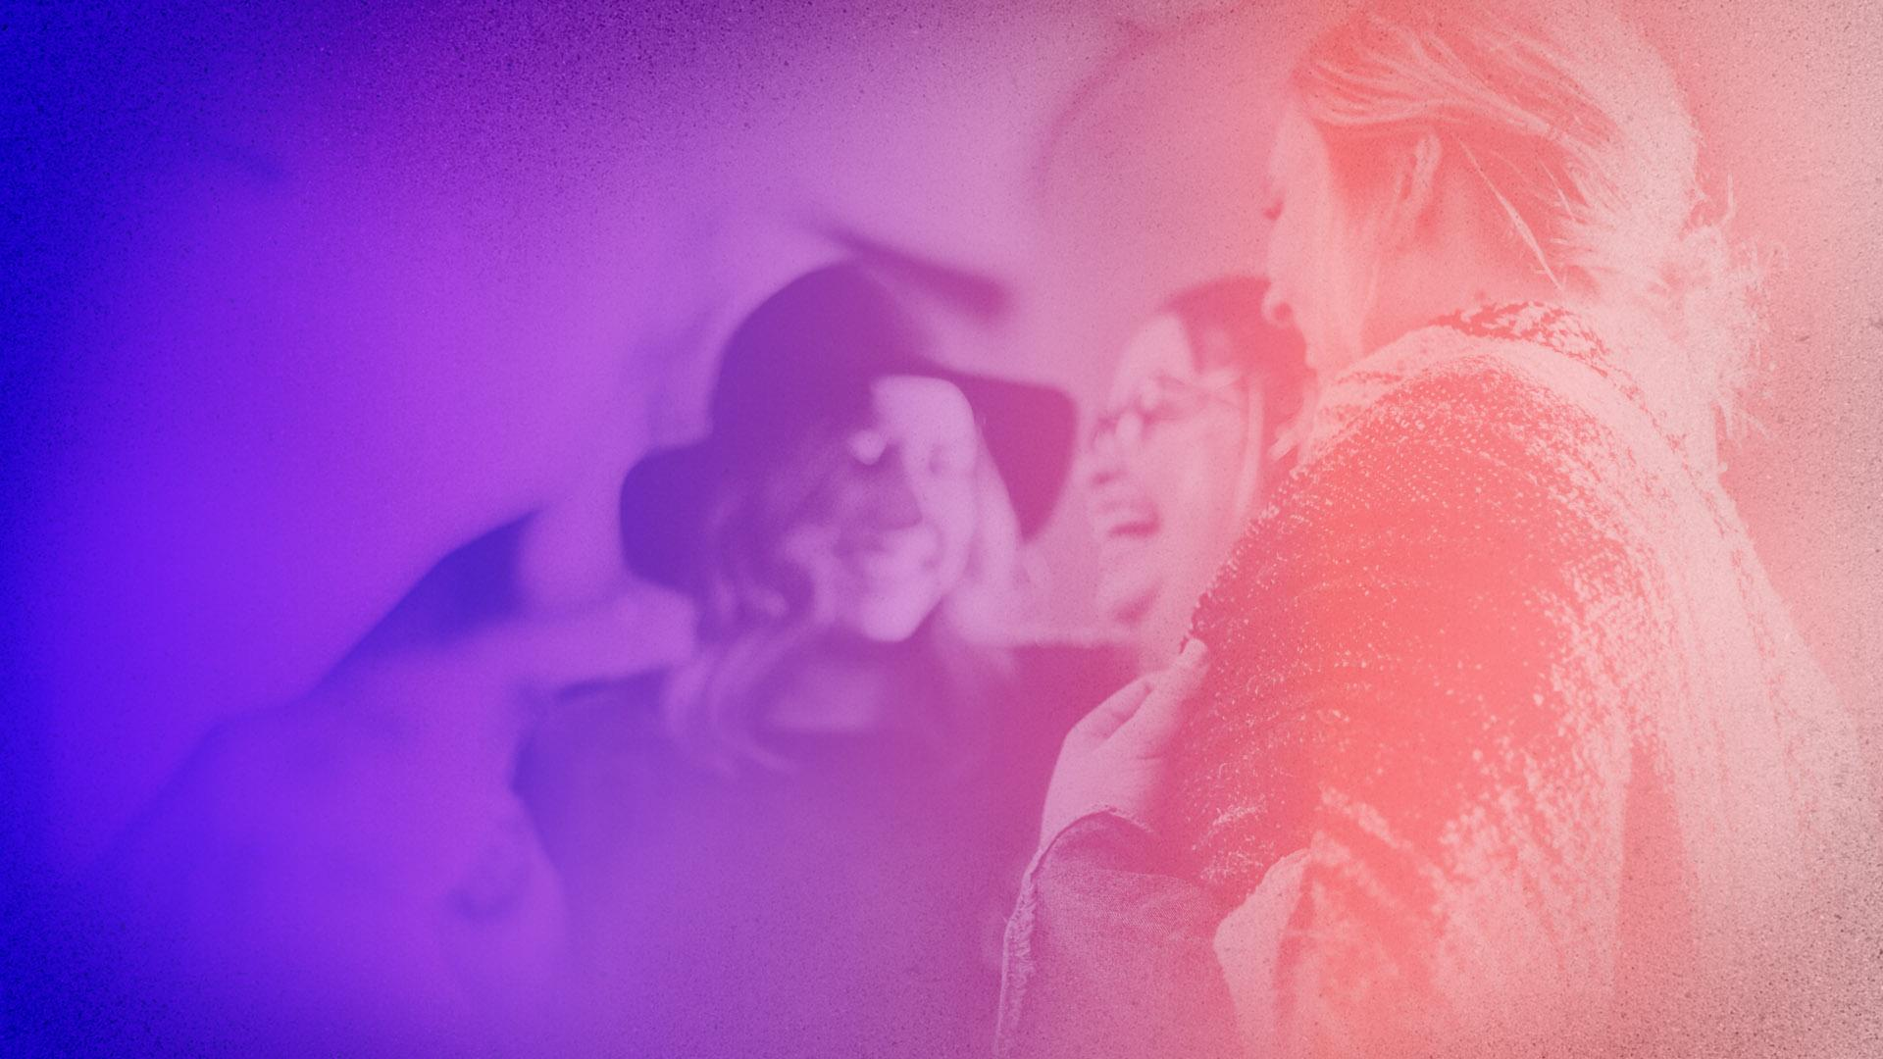

Mastering the Art of Conversations
By: Jordan Thibodeau & Joe Ternasky
This course is presented to you by the Silicon Valley Investors Club (svinvestorsclub.com), a global community of STEM professionals dedicated to making smarter investment and career decisions.

Slide 2
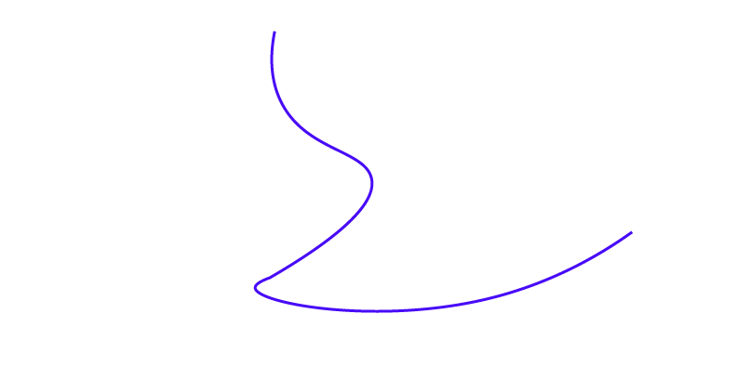
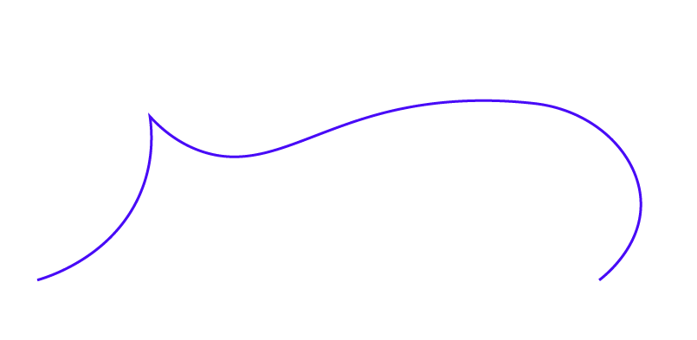
Lesson 1:
What is a conversation?

Slide 3
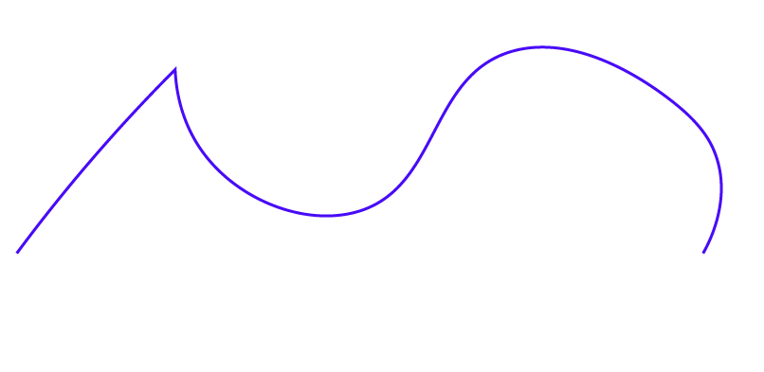
A good conversation is like a game
The goal of the game is to widen the channel of communication
A good conversation is a way to:
  share information
  express our feelings
  learn from others
  solidify personal bonds
  provide us with a needed energy boost
  a way to crystallize our thinking

Slide 4

Technology is destroying our ability to connect
In the olden days, if you didn’t like someone in your community, you still had to figure out a way to work with them
Due to technology, we find ourselves more connected to others than ever before
BUT
Most of these connections are tribal
We've forgotten how to connect with others outside of our echo chambers

Slide 5

We need deep conversations, not shallow ones
We predominantly engage in shallow conversations that focus on minor chit-chat or throw-away gossip
We aren’t listening to the other party so our conversations are centered around ourselves

Slide 6
To Do:
Think of the last great conversation you had. What made it great? Who was it with? Where did it take place? What emotions did you feel during the conversation?
Now think of the last bad conversation you had. What made it bad? Who was it with? Where did it take place? What emotions did you feel during the conversation?
With both situations in mind, think of what you did in the great conversation that would have made the bad conversation better?
Please complete the following homework exercise
Before we start our next lesson, you should take some time to reflect on your previous conversations by creating a conversations journal. A conversation journal will include the following columns: Date Of Contact, whom did you contact? Your thoughts before the conversation? What happened during the conversation? Were your initial thoughts correct? What did you learn from the conversation? How did the conversation make you feel?
Recommend Reading:
We Need to Talk: How to Have Conversations That Matter by Celeste Headlee
Recommended Lesson From Our Other Courses:
How To Accomplish Your Goals Lesson #2: Discovering the Critical Actions That Will Make Your Big Goal Achievable

